Slide 1
SchedulEd
CS 691 Asynchronous
Capstone
Team 1
Professor Henry Wong
Spring 2025

Slide 2

Agenda T
Team Member Roles and Responsibilities
Improvements
Project Description
Team Working Agreement
Schedule
Personas
MVP
Technologies
Algorithms
Product Backlog/Sprint 1 Test cases
Metrics/Team Velocity
Retrospective
Project Demo
Group Wiki Page

Slide 3
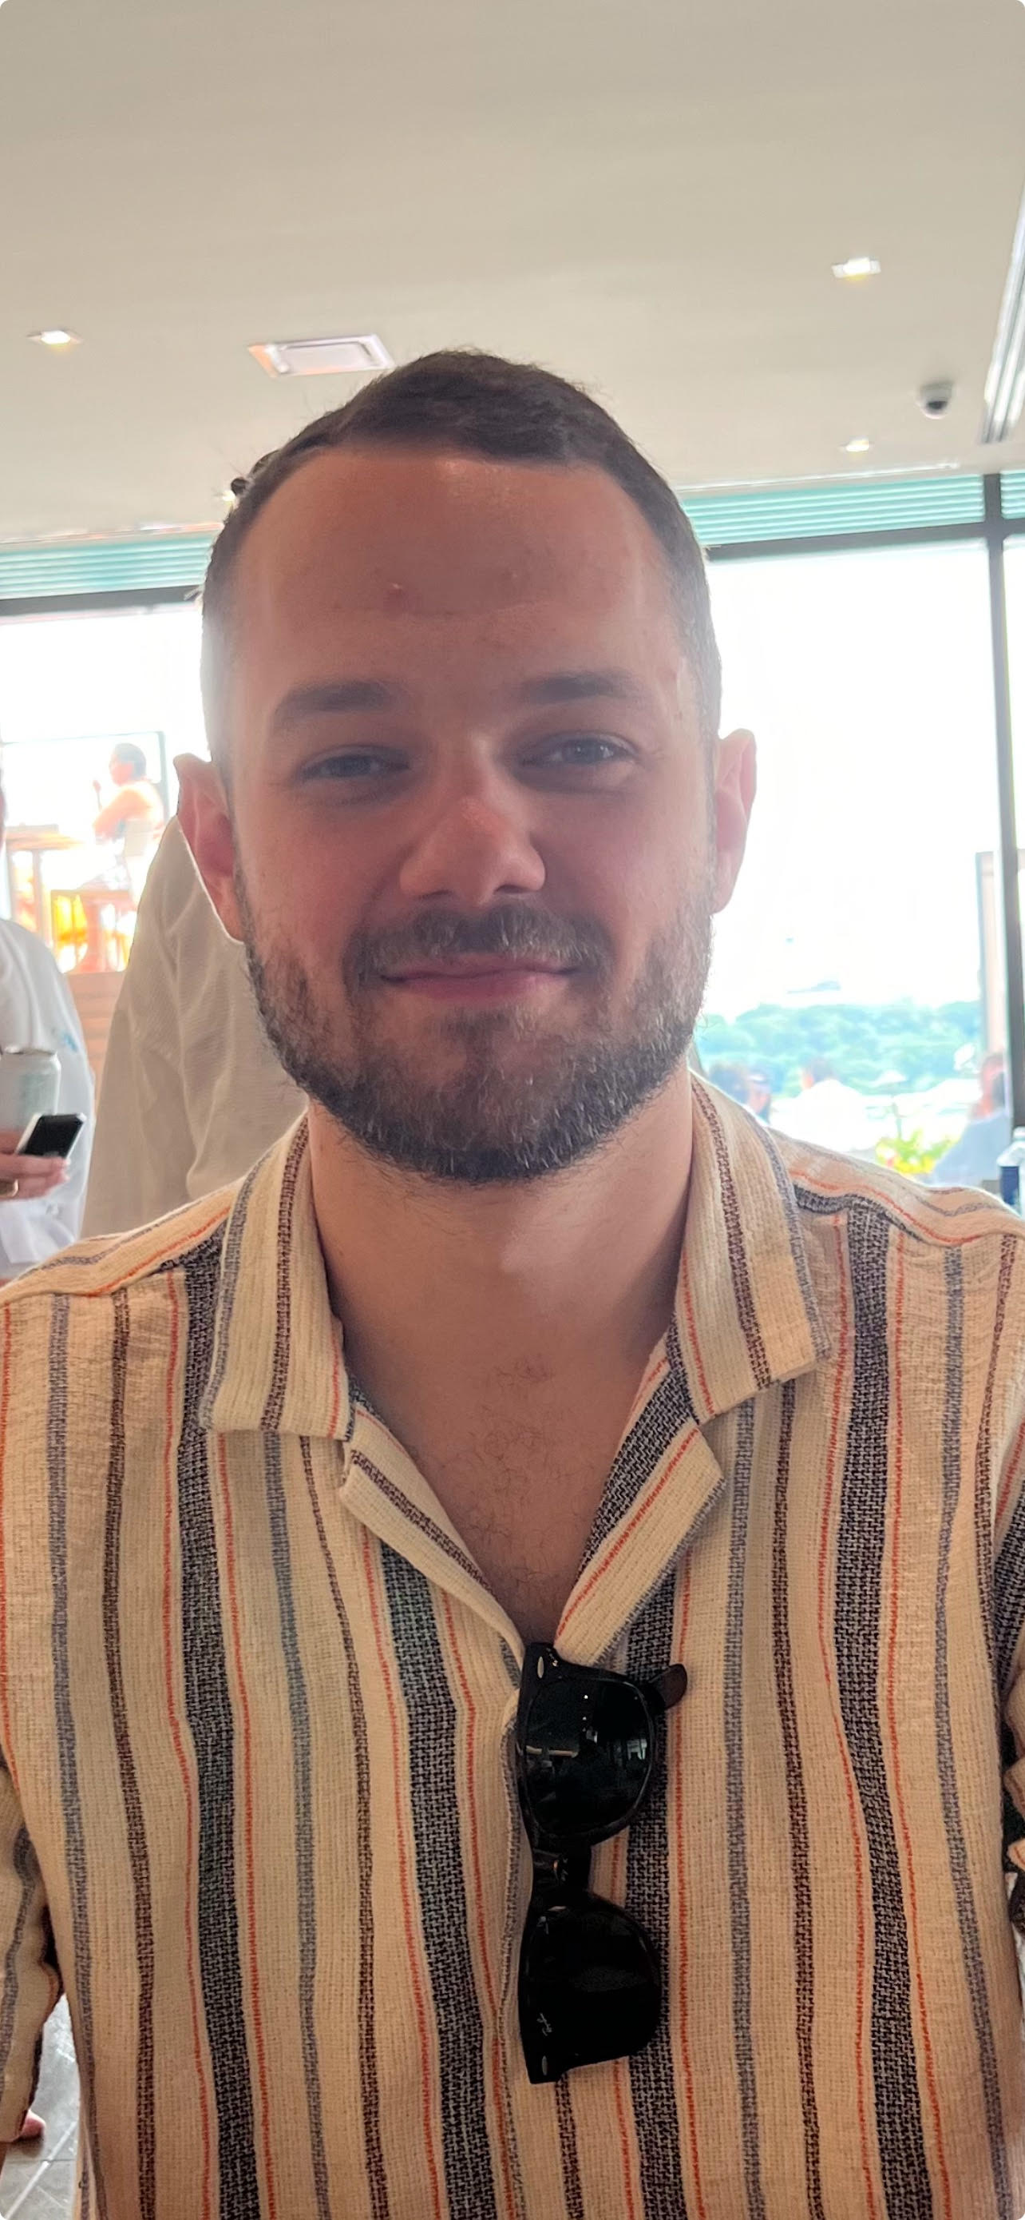
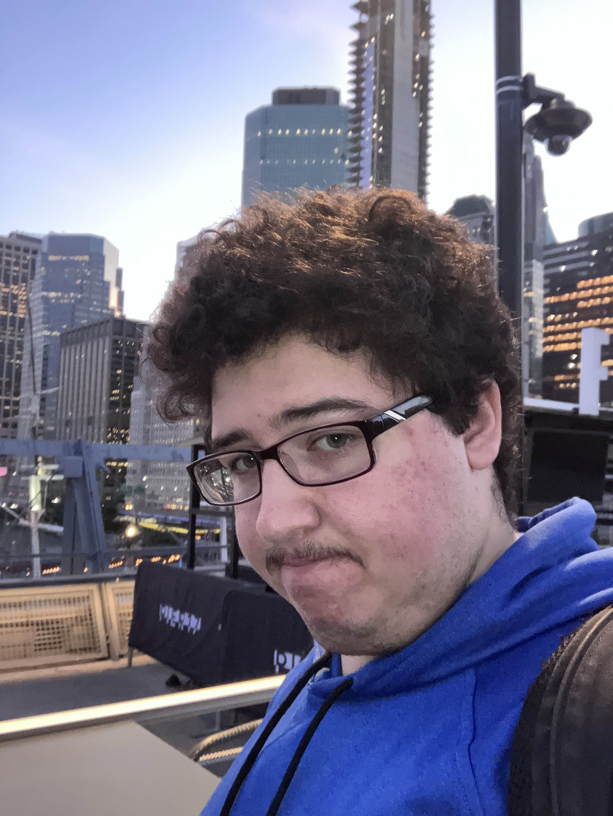
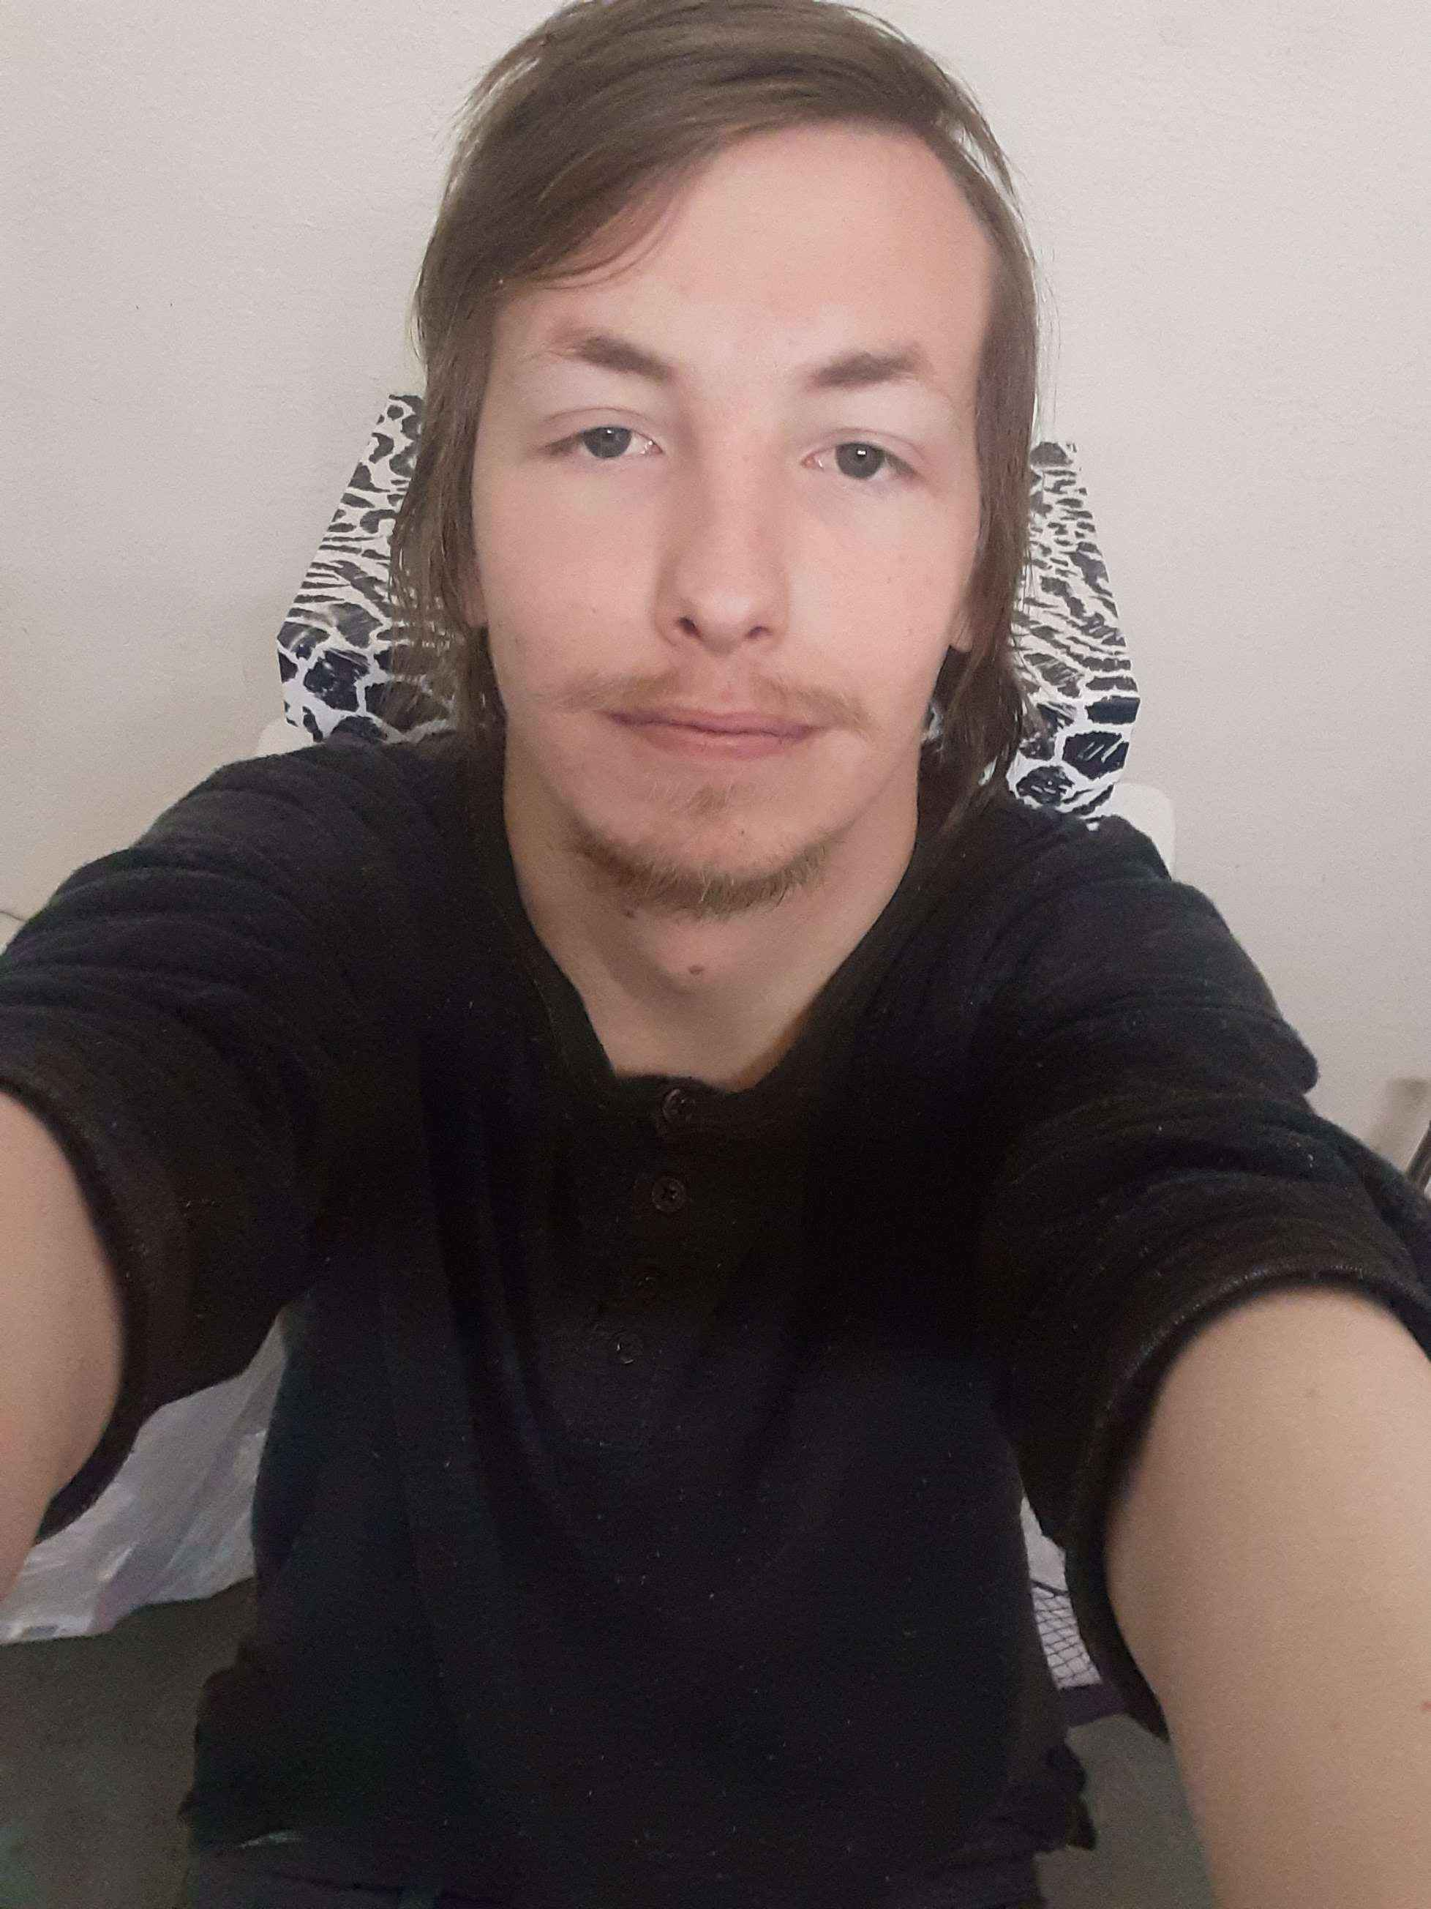
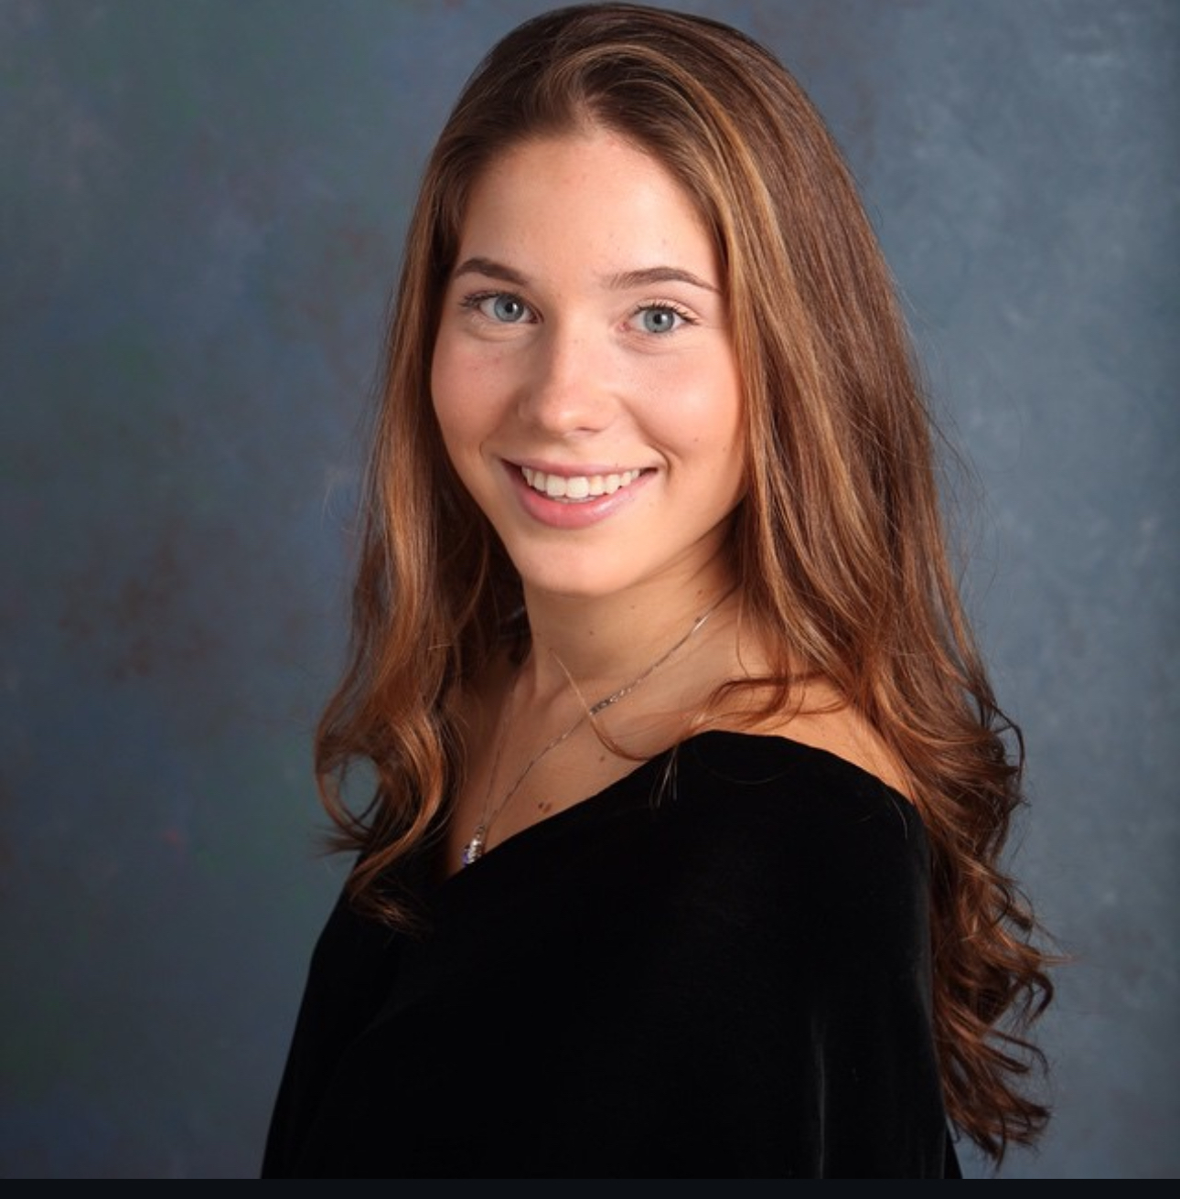
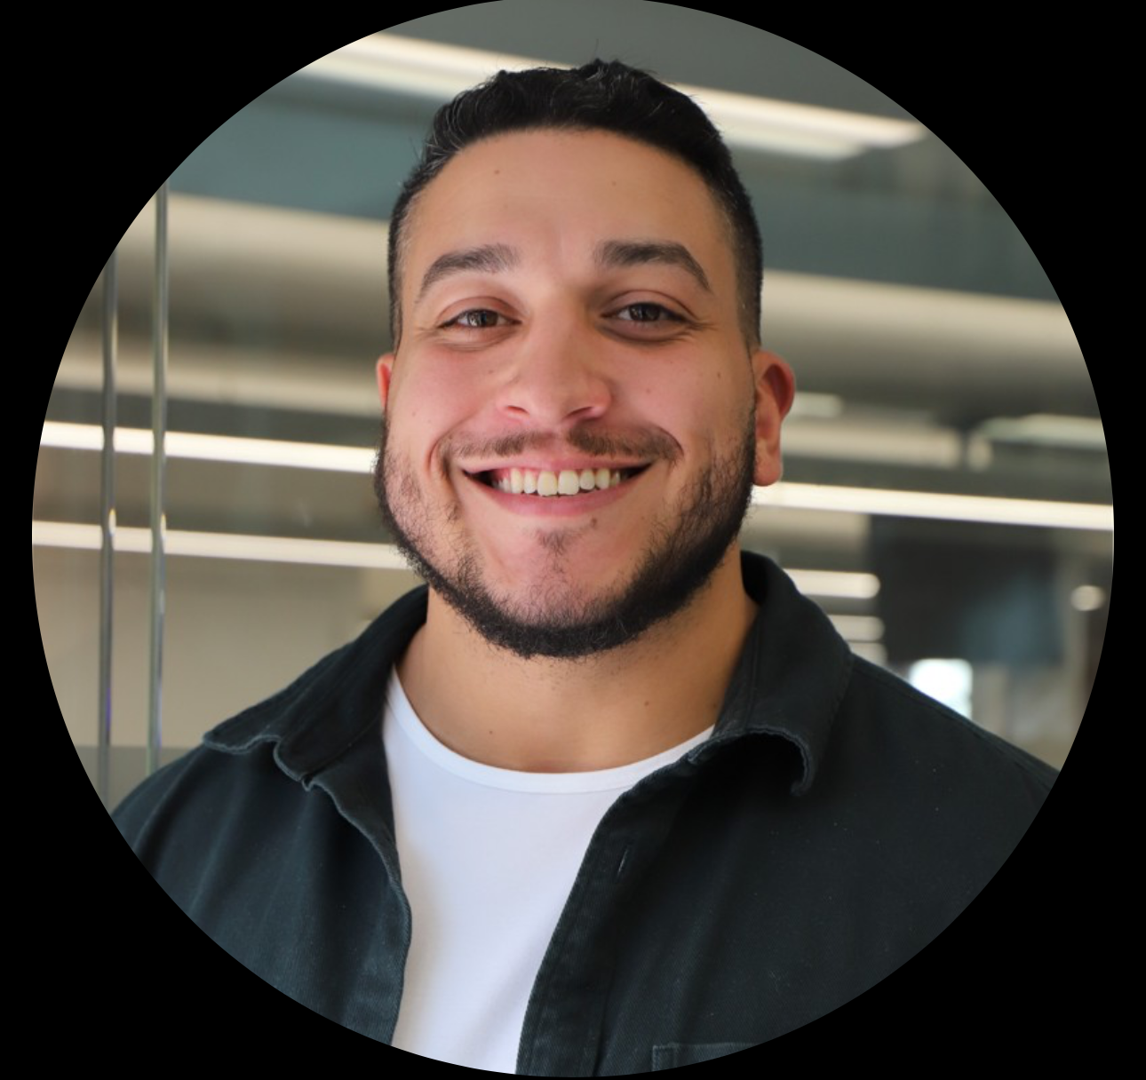
Team Members
Sabrina Scaccio: Scrum Master / Developer
Thomas D'Anna: Front End Developer
Justin Rivera:
Front End Developer
Victor Zapata:
Back End Developer
Michael Silva:
Back End Developer

Slide 4
Improvements T
Team met in a timelier manner, and we met twice a week for the whole month. If someone needed to miss the meeting, they gave a valid excuse. The communication was much better.
We all completed our tasks assigned to each person by the date that we wanted the task done by.
We came to a much better visualization of the product since we started.

Slide 5

Project Description T
ScheduleEd is a scheduling app that will assist teachers, parents, and students with the process of booking, managing, and tracking tutoring sessions. This app will focus on alleviating scheduling conflicts among all involved. Often, students have various commitments after school that are hard for the parents to manage. The times of these various extracurricular activities change. This has a trickledown effect on the teachers. This app will allow parents to book with a more flexible approach. They can go week by week, selecting times that work for them and their child. This app will eliminate scheduling conflicts, reduce ineffective communication, and avoid double-bookings and no-shows. In just the tap of a button, parents and students will be able to book, cancel, and reschedule appointments! The app will remind students/parents of their sessions and will allow the tutor to have a better scope at their week. It also will allow the tutor to notify parents of available times, rather than going back and forth, guessing what time will work. This app will aid many teachers, private tutors, and tutoring centers with a way to manage their learning schedule in a much more organized fashion.

Slide 6
Team Working Agreement T
All team communication will occur using Microsoft Teams/I-Message
We remind each other that we are all in this together, and when conflicts do arise, we tackle them as a team and will help guide each other.
Meetings will be held using Microsoft Teams. We will meet weekly on Wednesdays @8:00 pm. We will add meetings as needed, to stay on top of deadlines. Meetings will be about a half hour.
At the beginning of each sprint, we will hold a sprint planning meeting, in which everyone is given their tasks.
Before the sprint is over, we will hold a meeting on our retrospectives.
Each team member will understand their role and what they are responsible for.

Slide 7
Team Working Agreement CONT. T
Everyone will adhere to the due dates and the due date of when we want tasks done, will be discussed at the meeting.
Each team member has their own task but is reminded that we are a team, and things may not go as smoothly for others.
When there are conflicts within your own task, it is required that you tell the team immediately so that they can assist you and there are no delays in due dates.
Each team member is asked to come to the meetings fully prepared with their task.
We will continue to learn through this project and produce new innovative ways to tackle this capstone project.
Final work should be submitted as follows:
The team has reviewed your work
There are no errors within your code
All tasks were tested
Work meets the criteria of the class
Code is uploaded to Github
All aspects of the sprint are complete

Slide 8
Project Schedule
 | Start | End
Sprint 0 | January 21st | February 10th
Sprint 1 | February 11th | March 10th
Sprint 2 | March 11th | April 7th
Sprint 3 | April 8th | May 5th
Weekly Meetings!
Sunday /Wednesday @ 8pm! V

Slide 9

Persona 1 T
Kathy is a private tutor working both online and in-person. While she enjoys teaching, managing her growing client base has become increasingly difficult. She often struggles with overbooking and scheduling conflicts, as manually tracking appointments leads to occasional double bookings or missed sessions. With an automated scheduling system, students could book sessions based on her availability, preventing conflicts and last-minute mix-ups. A student profile feature would help her store session notes and track progress efficiently, ensuring personalized lesson plans for each student.
Kathy - Wants a comprehensive tutor scheduling planner for managing multiple clients.

Slide 10

Persona 2 T
Jake is a 16-year-old high school student juggling multiple tutoring sessions alongside his regular schoolwork and extracurricular activities. He often forgets about scheduled lessons or struggles to find time for rescheduling when conflicts arise. He has a hard time keeping track of assignments and notes from his tutoring sessions, often misplacing important study materials. With automated reminders, he would never miss an appointment, reducing last-minute cancellations and lost study time. A built-in calendar would help him visualize his schedule, ensuring he doesn’t double-book tutoring with other commitments. A session tracking feature would allow him to store lesson notes, assignments, and key takeaways in one place, making it easier to review material when studying.
Jake – Looking for centralized app for managing tutoring sessions and study material

Slide 11

Persona 3 T
Debra is a busy mother of 3, trying to balance her work schedule while ensuring her 10-year-old daughter stays on top of her tutoring sessions. Debra often finds it challenging to keep track of lesson times, and her daughter's overall progress. In the chaotic life of a parent of multiple children, tutoring schedules sometimes slip through the cracks, leading to missed or forgotten sessions. She also struggles to stay updated on what Emily is working on in her sessions, relying on scattered notes from tutors or brief updates from her daughter. A session log feature would provide insight into Emily’s progress, giving Debra access to lesson notes and assignments so she can stay informed and involved in her child’s learning. A tutor scheduling app would be a game-changer for Debra, allowing her to keep all of Emily’s tutoring information in one place.
Debra - Keeping track of child's appointments and progress.

Slide 12
MVP V
Accounts/Firebase Integration
Tag based Search System
Schedule/Book Sessions
Google Integration

Slide 13




Technology M
Frontend
Backend

Slide 14
Algorithm M
Machine Learning Models (Advanced Matching)
A decision tree predicts the best tutor for a student based on their learning style, subject, and past interactions.
Content-Based Filtering
If a tutor has a history of working well with middle school students in "Science," they will be recommended to students within that range.

Slide 15

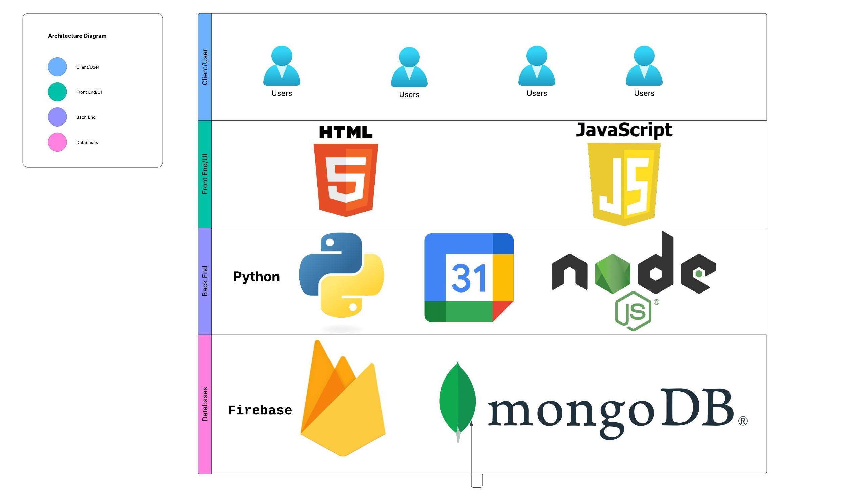
Architecture Diagram J

Slide 16
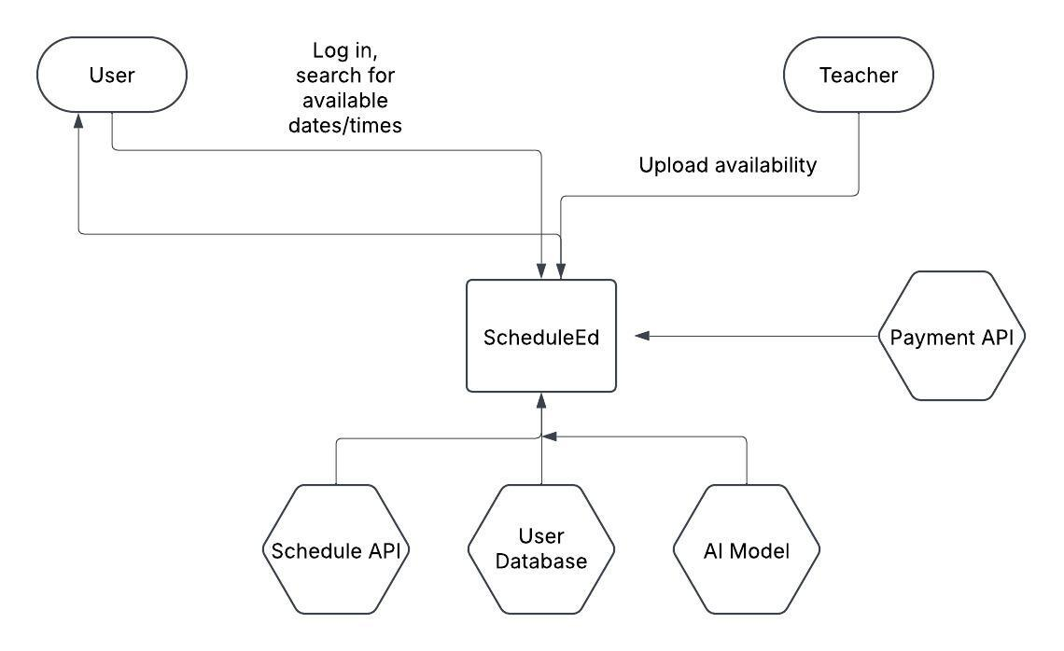
Context Diagram J

Slide 17
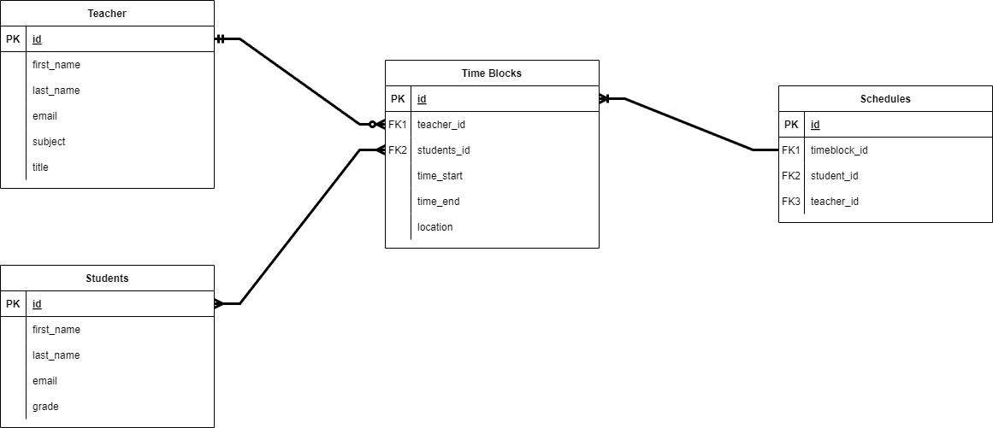
ER Diagram V

Slide 18
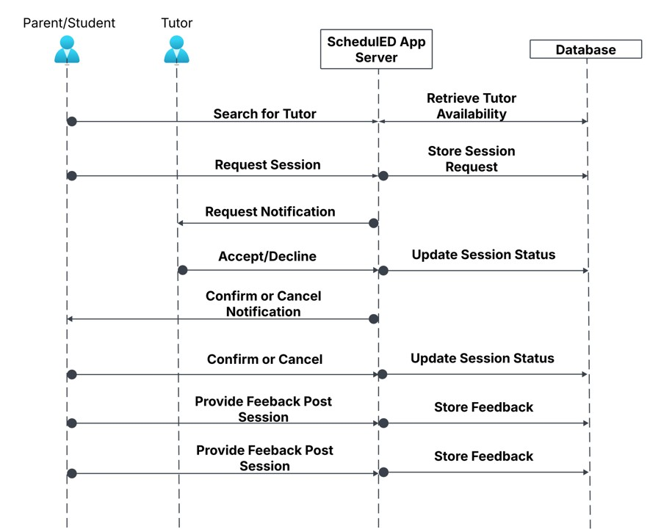
Sequence Diagram T

Slide 19
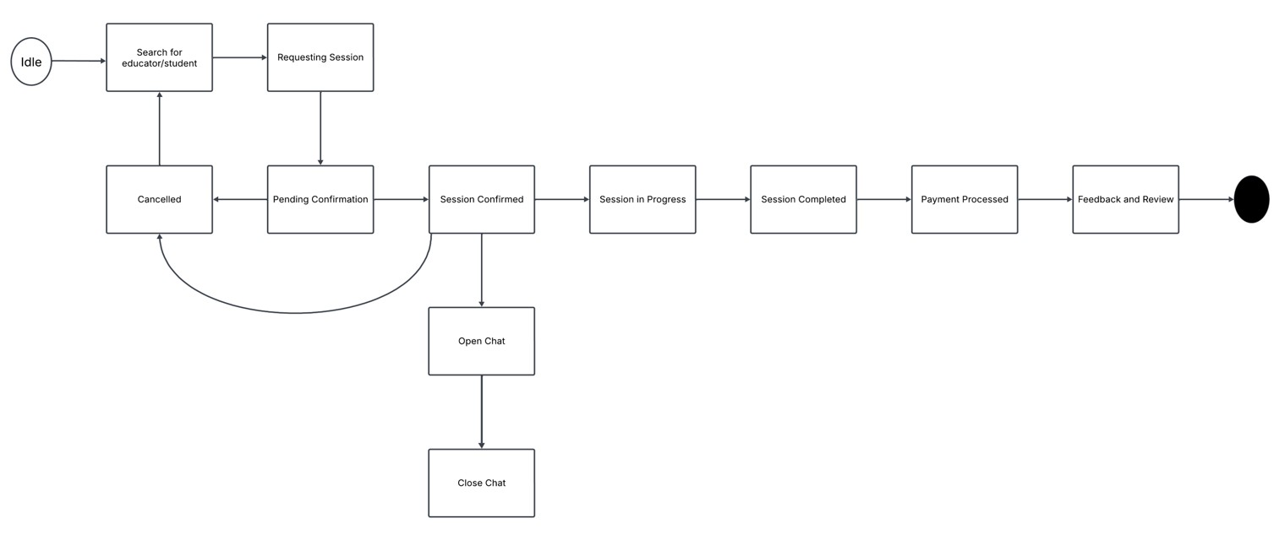
State Diagram T

Slide 20
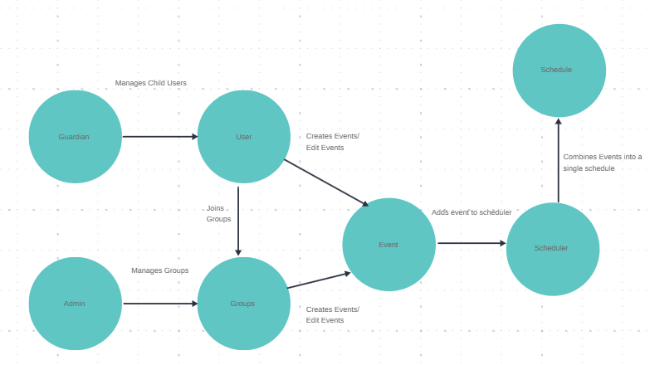
Concept Diagram M

Slide 21
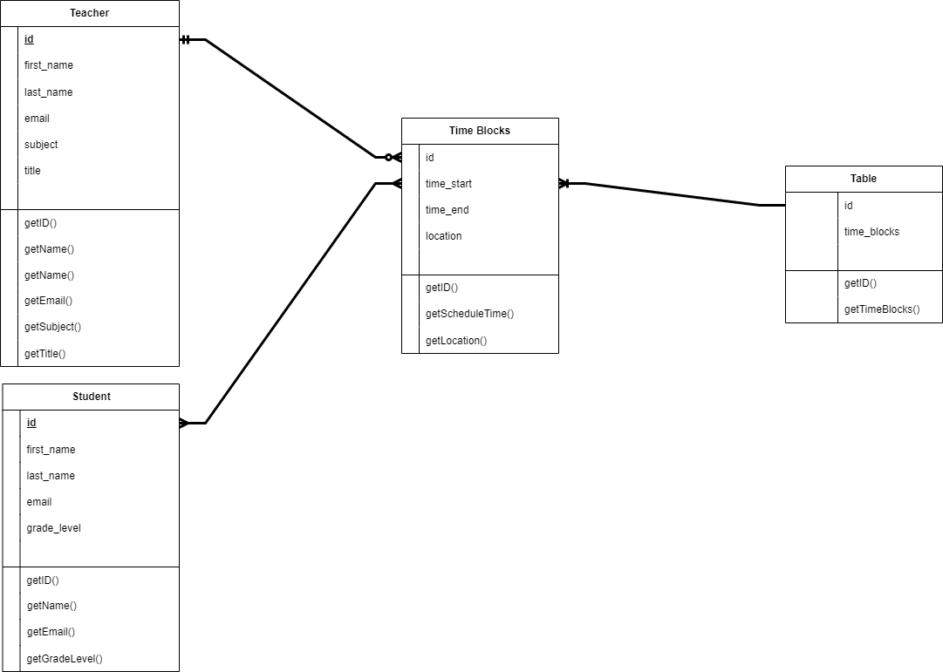
Class Diagram V

Slide 22
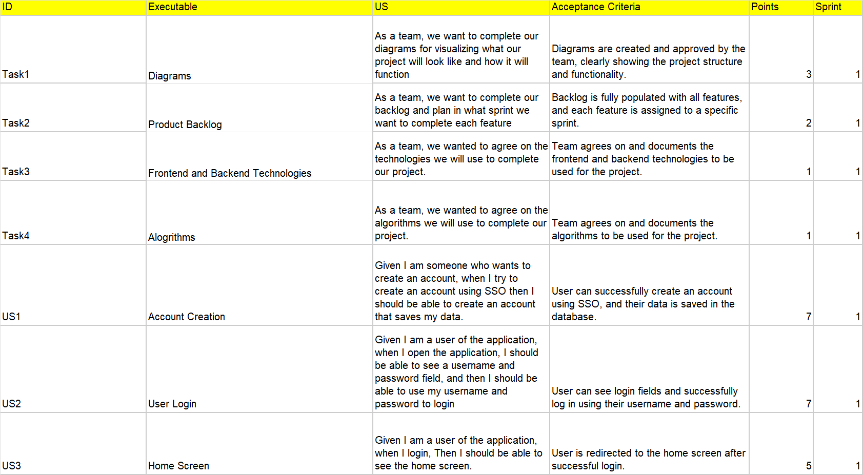
Product Backlog S

Slide 23
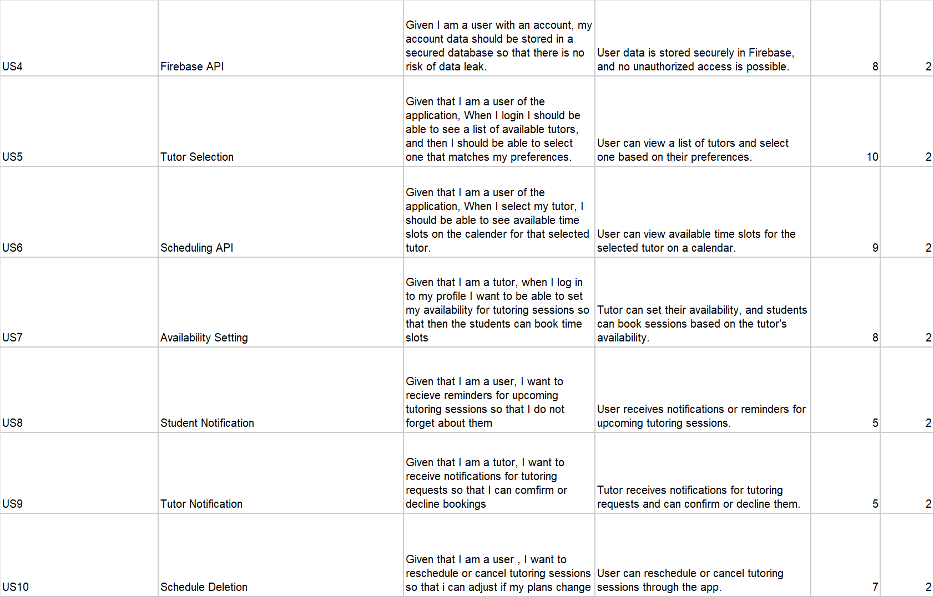
Product Backlog T

Slide 24
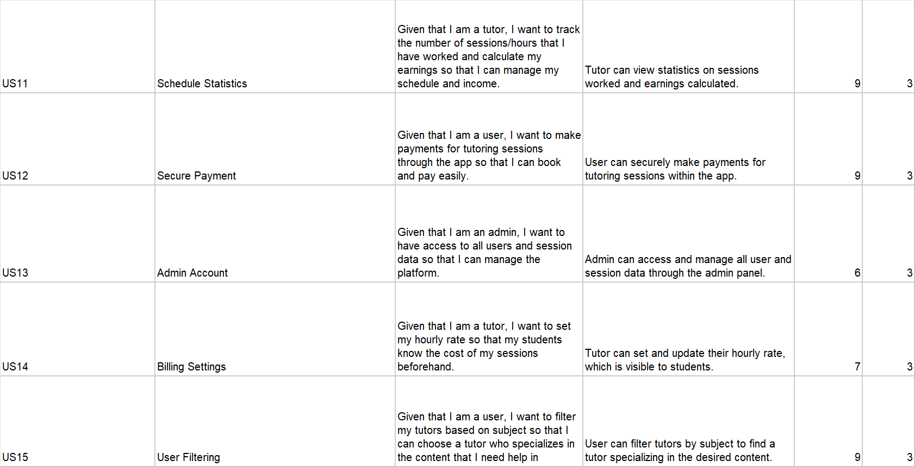
Product backlog T

Slide 25
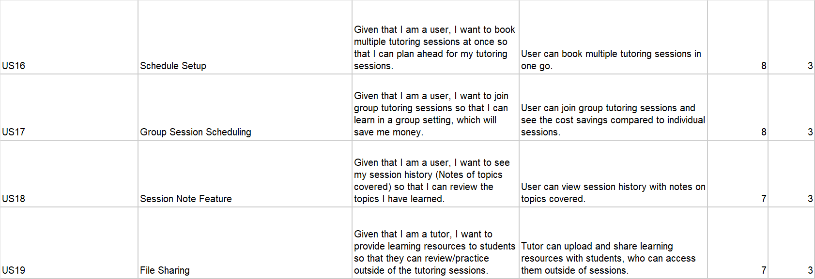
Product Backlog T

Slide 26
Sprint 1 Stories T

Slide 27
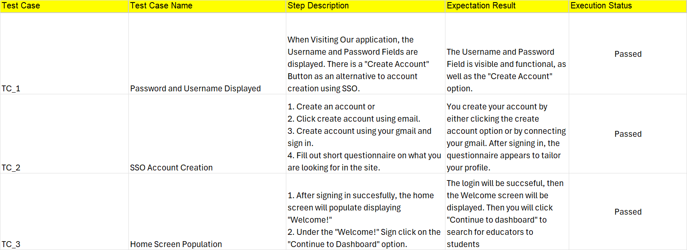
Test Cases Sprint 1 T

Slide 28
Team Velocity 26/26 Story Points Completed J
Task1: Diagrams are created and approved by the team, clearly showing the project structure and functionality. 3 Story Points Completed Task2: Backlog is fully populated with all features, and each feature is assigned to a specific sprint. 2 Story Points Completed Task3: Team agrees on and documents the frontend and backend technologies to be used for the project. 1 Story Point Completed Task4: Team agrees on and documents the algorithms to be used for the project. 1 Story Point Completed US1: User can successfully create an account using SSO, and their data is saved in the database. 7 Story Points Completed US2: User can see login fields and successfully log in using their username and password. 7 Story Points Completed US3: User is redirected to the home screen after successful login. 5 Story Points Completed

Slide 29
Metrics Committed/Completed Ratio J
26 Story Points completed out of 26 Story Points = 100% Completed

Slide 30
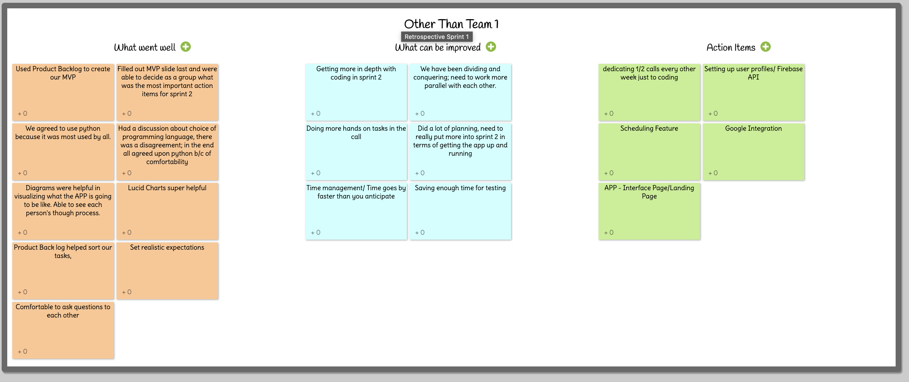
Retrospective S

Slide 31
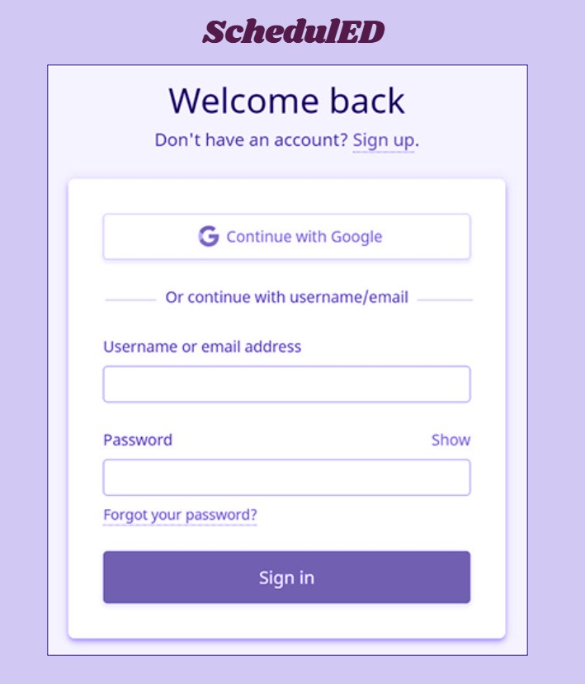
Project Demo M

Slide 32
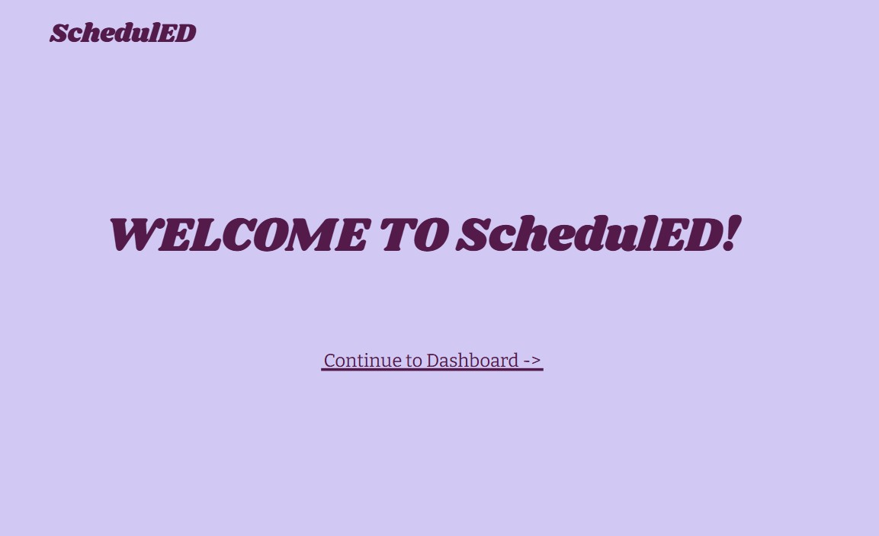
Project Demo M

Slide 33
Group Wiki Link
https://github.com/htmw/2025SA-Team1/wiki

